Slide 1
电写与笔写的整合教学— “电写为主、笔写为辅” 在华裔班低年级教学中的应用与反思
王祥寧
Associate Professor of Teaching
Coordinator of Chinese Language Program
University of British Columbia
Presented in L2 Hanzi Teaching and Learning in the Digital Age
Notes:
眼见为凭--》实例展示

Slide 2
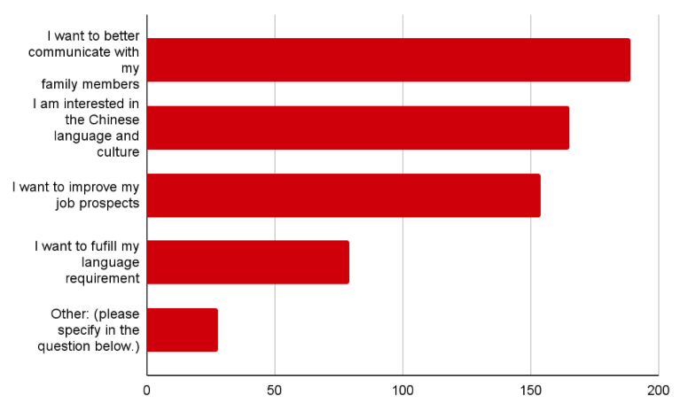
Part 1: WHY 为何电写与笔写并进？为何电写为主，笔写为辅？
UBC Heritage Student Needs Analysis 2022
华裔学生的学习目的：
3 communication modes
Interpretive
Interpersonal
Presentational
听、说、读、写/打？

Slide 3
Heritage Student Needs Analysis 2022
2. 华裔学生的学习特征：
华裔学生认为自己writing skill最差，reading skills 次之
其中差异性极大，但针对writing skill的自我评估相似地低

Slide 4
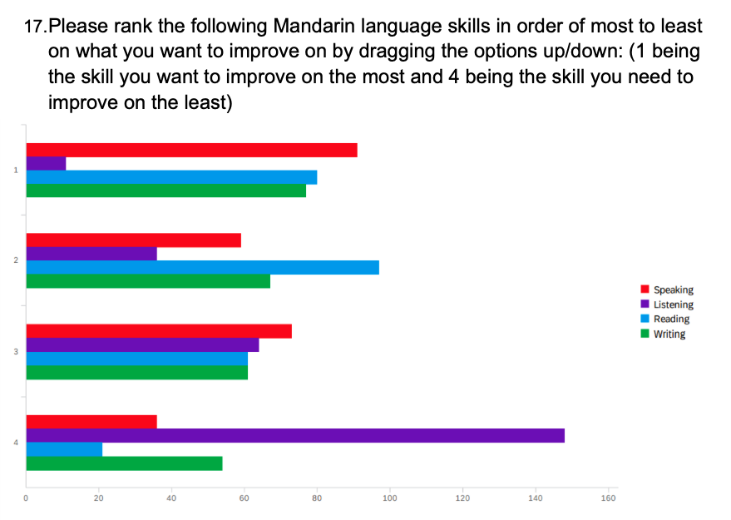
3. 华裔学生的学习目的/目标：
一年级：希望提升说、读、写的能力
二年级：希望提升读、写、说的能力
初上中文课的学生，会确认是否需要“手写字、手写作业” (差异化、多元性🡪 包容性)

Slide 5
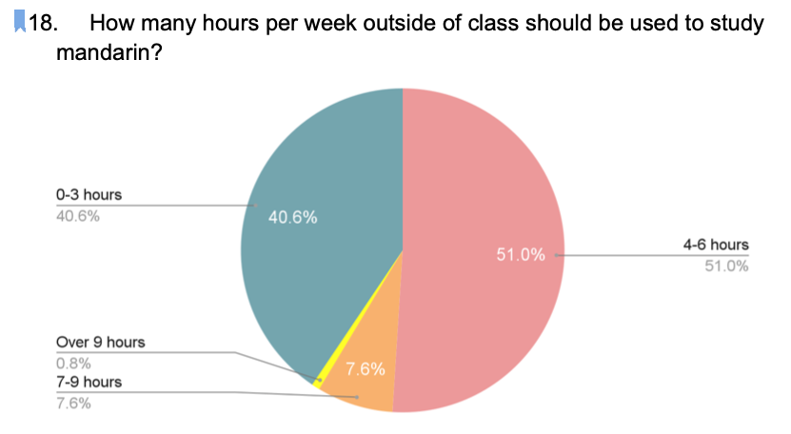
理想与现实平衡的教学设计
4. 华裔学生的学习期待
课上时间：每周3小时教学 + 1小时口语练习
如何符合学生的期待？每周课外4-6小时应如何分配？
(时间 VS 教学目标：语言学习/听说读写+文化理解…)

Slide 6
Rationalization and Motivation of Learning
Input output
Listening
Speaking
Reading
Writing

Slide 7
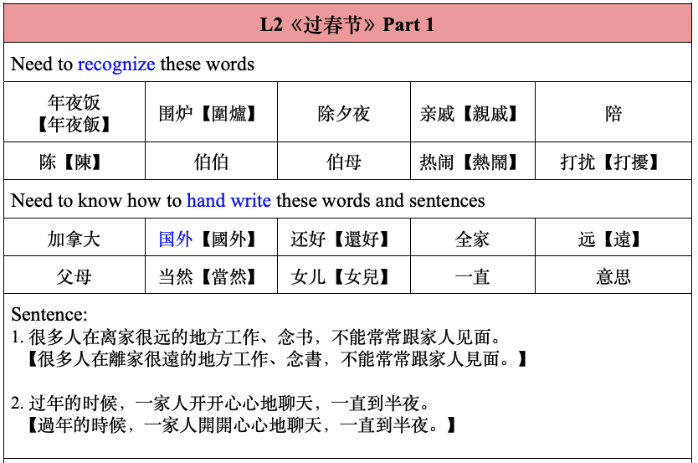
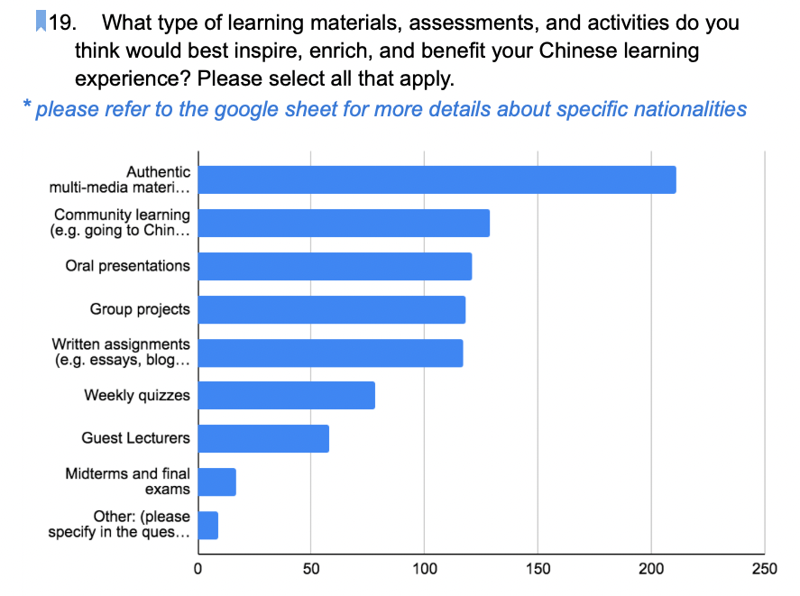
基于华裔低年级学生的学习目的、特征与需求，我们拟定循序渐进、针对reading skill & writing skill的学习目标：
Reading：top-down + bottom-up (见树+见林)
【学】从部件识别、认字、认词开始，逐步强调篇章理解；阅读长度越来越长；阅读量逐步加大；逐渐加入补充文章，特别是真实阅读语料
【教】汉字部件、组成、部首、认字/认词猜字义/词义、理解长句与篇章；错别字的意识 (我vs找、土vs士、贝vs见、请vs情、上传vs上船vs上床、好吗 vs 好嘛 vs 号码)
Writing：
【学】一年级初到二年级末-- 手写要求由少到多(三年级：再变少)；手写由简入繁 (handwritten your name；recognized vs handwritten key words；handwritten reorganized sentences）
【教】基本笔顺、部首、汉字的组成与整体性 (女子vs好、我、美、谢、事)
Notes:
读写不分家

Slide 8
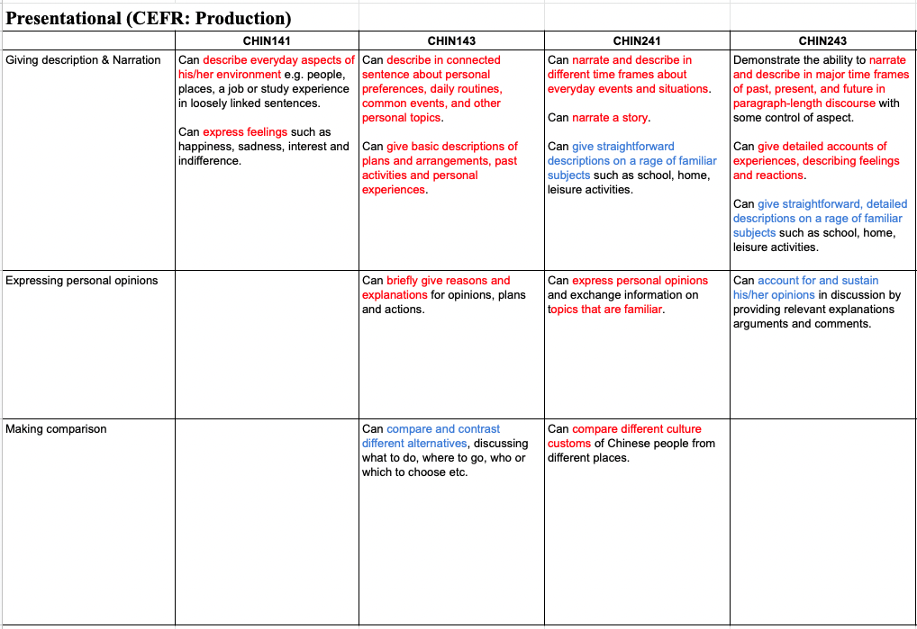
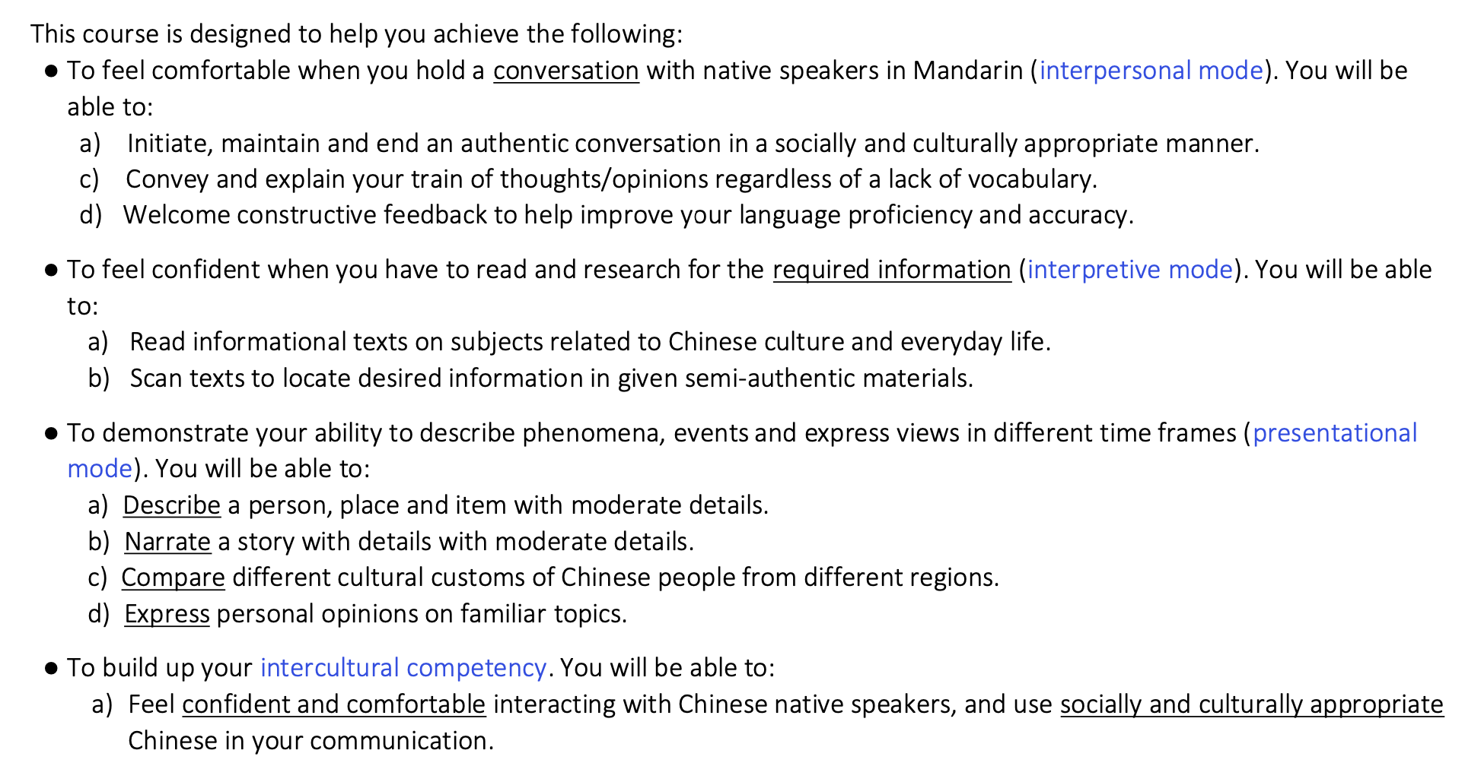
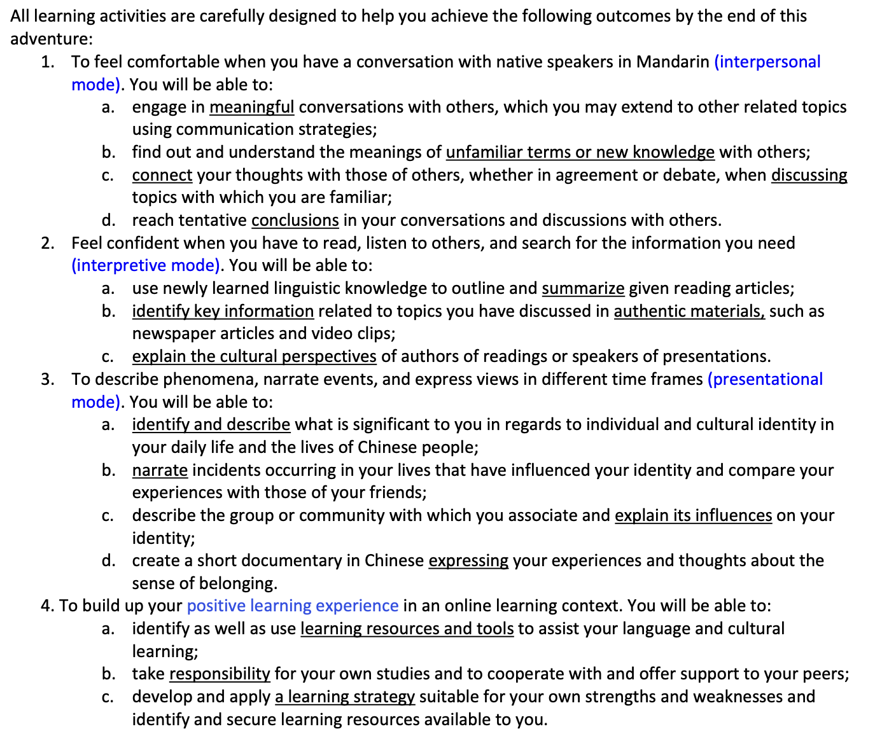
循序渐进、整合性的安排
【一年级】
Reading:
to recognize high-frequency characters in everyday scenarios or conversation
to identify the main themes and key vocabulary that we learn when we read informational texts on topics closely related to the daily life topics covered in this course.
Writing:
to compose simple and short paragraphs useful in your life, such as an email to your family member, simply writing(typing) a self-introduction, and writing(typing) a summary of your conversation with a friend.
【二年级】
Reading：
supplementary authentic material reading and listening (flyer, WeChat messages, 小红书, online article, etc.)
extensive reading task (book)
Notes:
适可而止

Slide 9
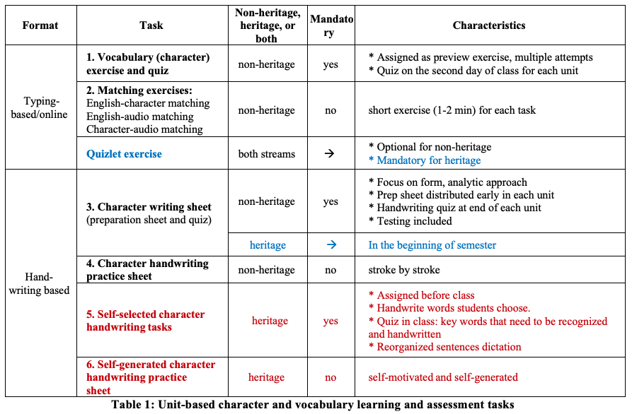
Part 2: WHAT？
电打实例展示与学生写作能力的评量：
(1) 字和词的学习（每课练习, input & output）
Notes:
5. and 6. Self-selected or self-generated character handwriting tasks in heritage classes As is the case for non-heritage students, handwriting tasks for heritage students are designed to further develop their autonomous learning ability through flexible character exercises in recognition and handwriting, many of which are based on their own personal interests and preferences. Heritage students at the beginner-level can pick out words they identify as useful or meaningful instead of doing pre-assigned repetition of handwriting work. We believe that giving students choice, flexibility, and control in practices motivates them to achieve their best writing and maintain interest, and enhances their sense of agency in the learning process. Students can gradually develop confidence when deciding on learning priorities and approaches that work best for them. For those who wish to learn handwriting, other exercises of a more comprehensive and exploratory nature can emphasize skills that are important to them. The example below shows one student’s handwriting practice based on words she chose.

Slide 10
【Gimkit】 form + sound + meaning （+ simple reading & grammar）
Notes:
打字会不会认不得字--》 认字的训练

Slide 11
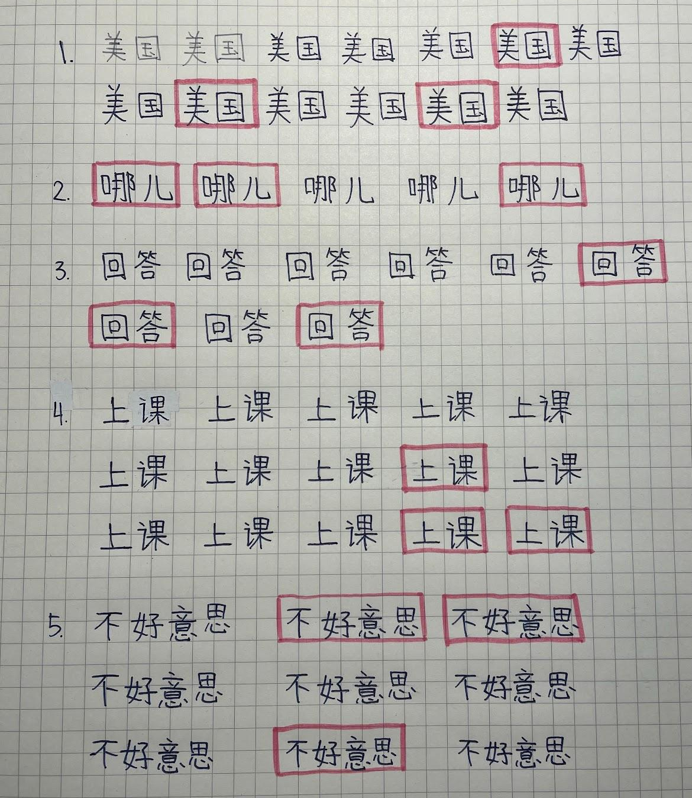
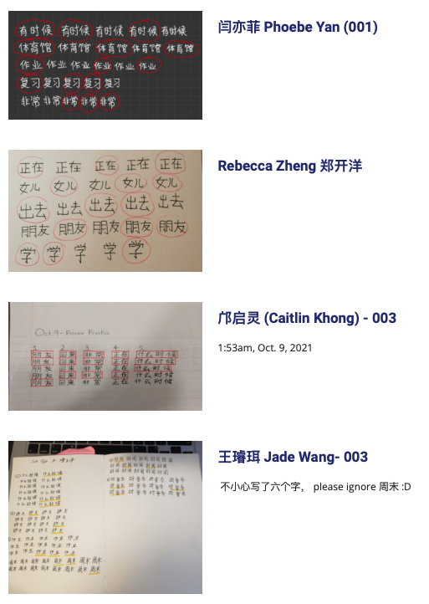
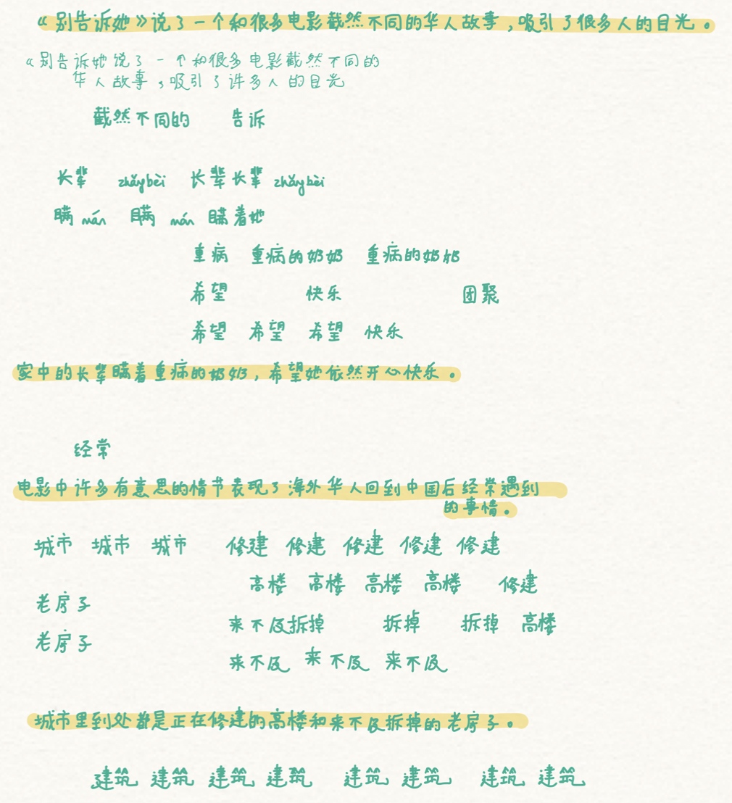
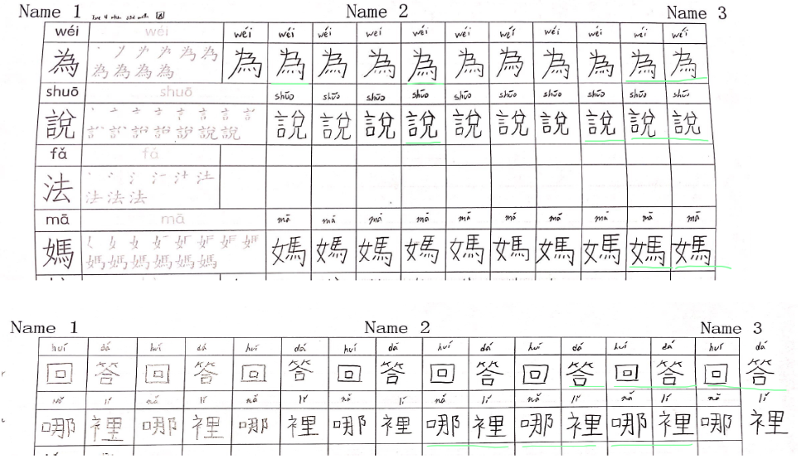
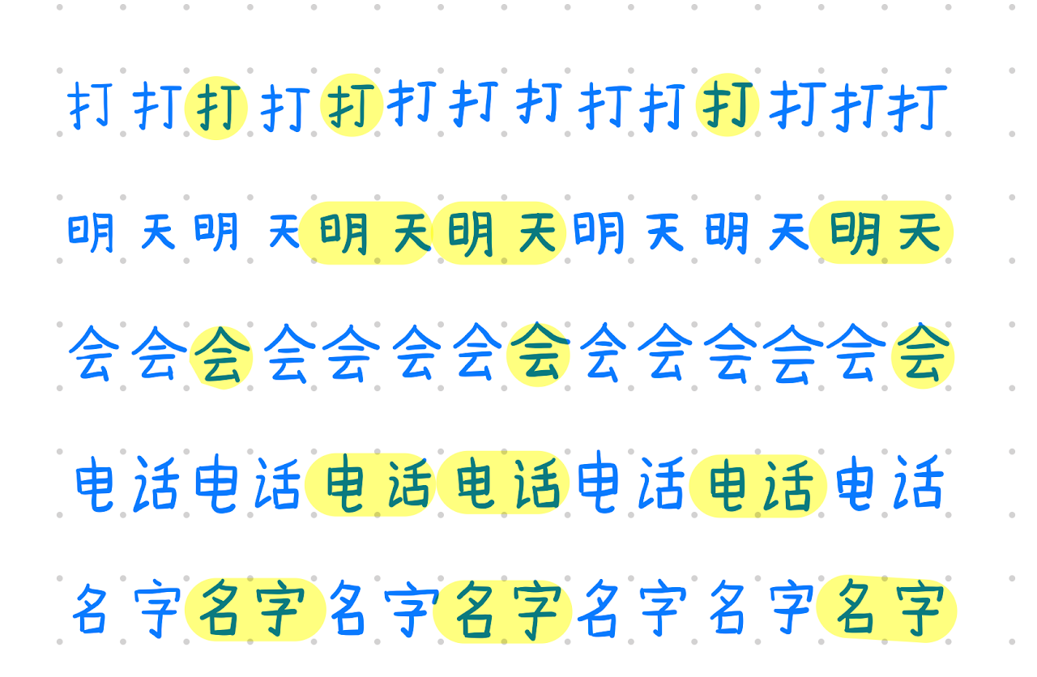
【Self-chosen handwriting practice】Self-motivation and self-driven improvement
Required：Level 1
Optional: Level 2

Slide 12
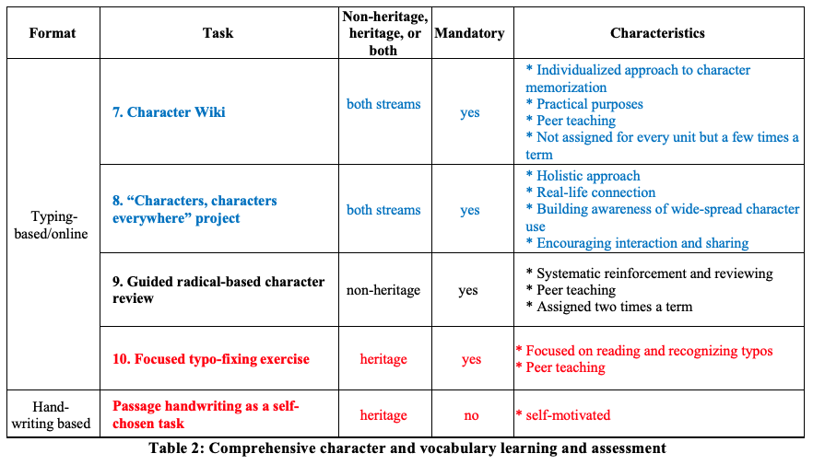
(2) 字和词的学习
(非每课练习，包括汉字的组成和应用，生活中的汉字、减少错别字)

Slide 13
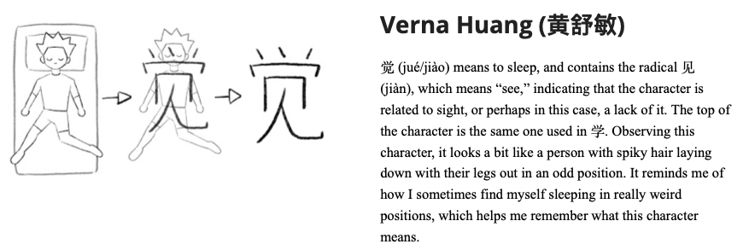
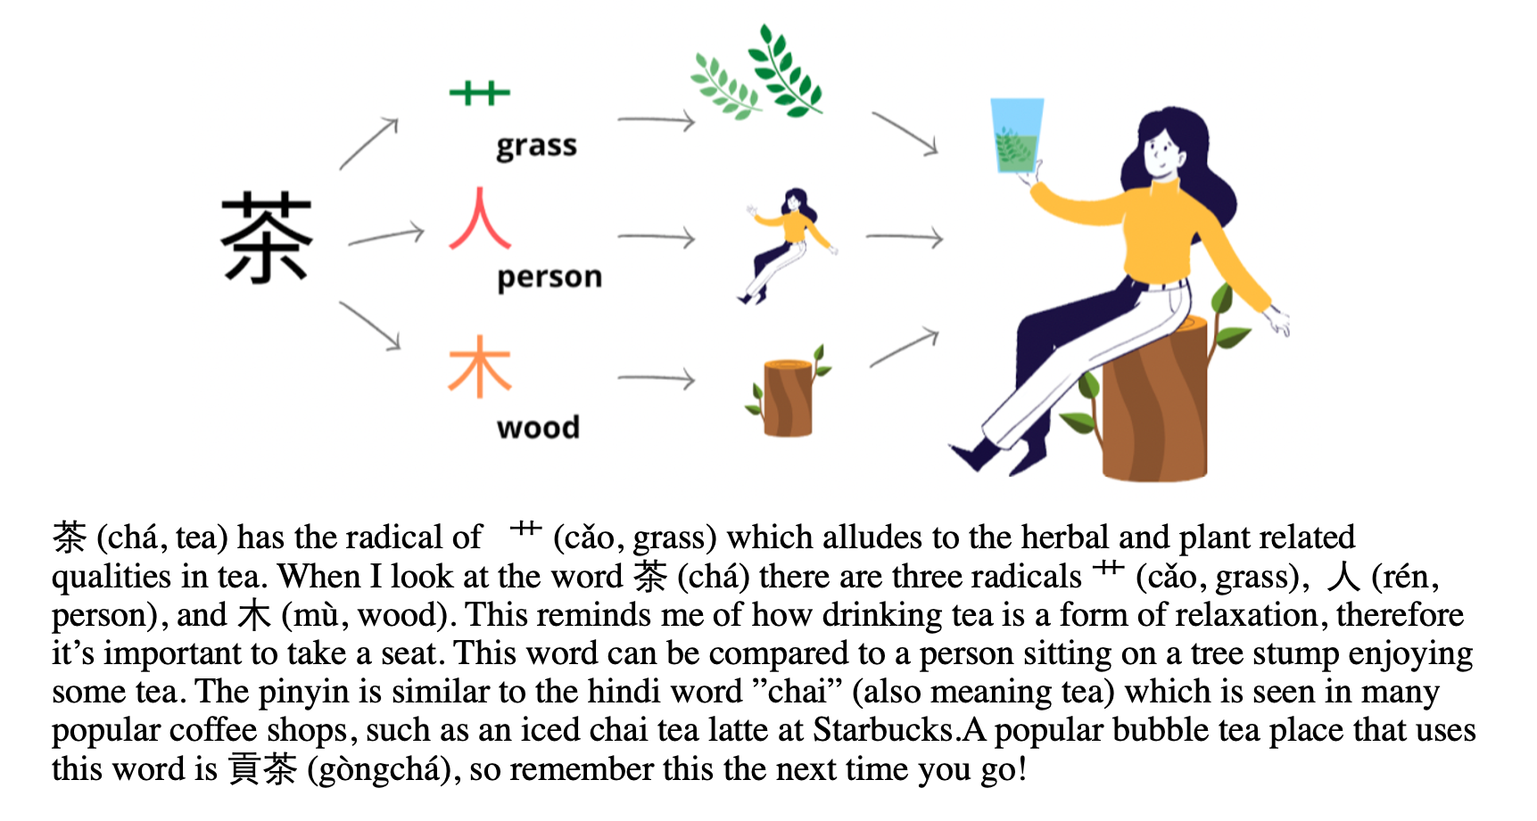
【Character Wiki:】form + sound + meaning
form & meaning & culture
form & meaning; 觉 vs 学
form & sound & meaning

Slide 14
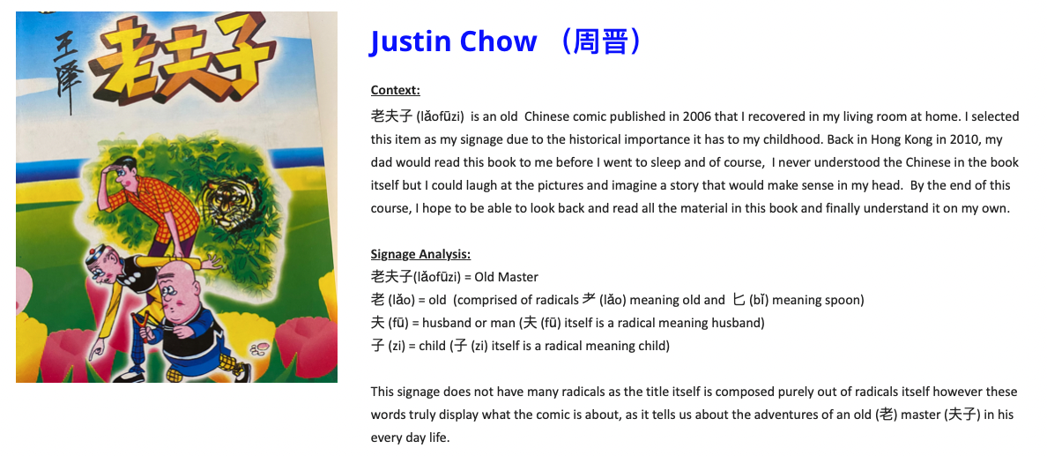
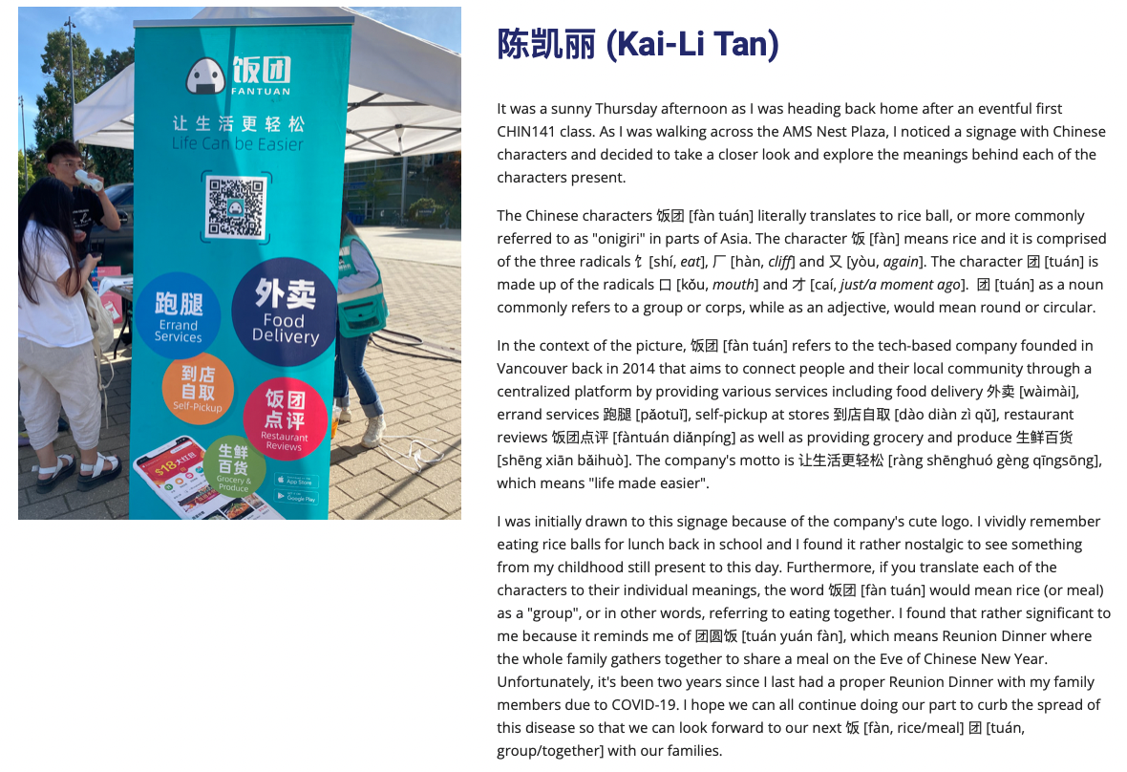
“Characters, Characters Everywhere” ：汉字在华裔学生的生活中🡪 汉字是文化的载体、社群认同
Notes:
不用教“文化”

Slide 15
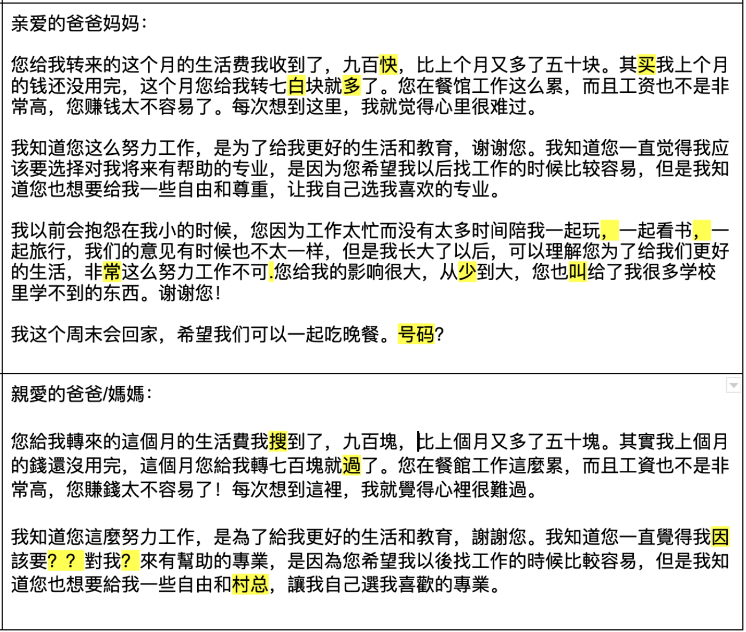
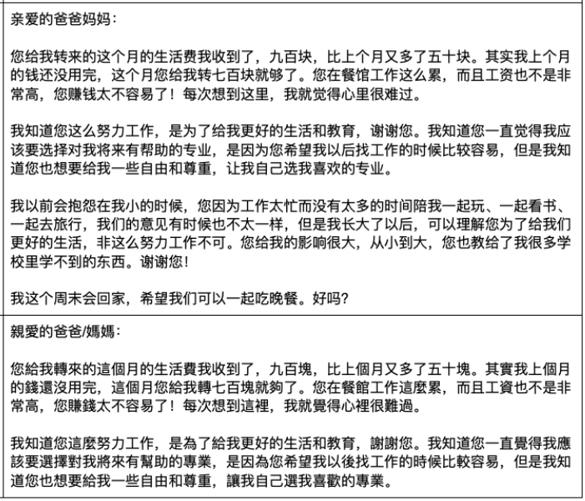
【Focused Typo-fixing Exercise】 Self-awareness and Self-monitoring of Typo
1. 辨认错别字
2. 自我监测
3. 分词能力
4. 阅读能力 (问问题)
+ 协同学习
问题🡪机会!

Slide 16
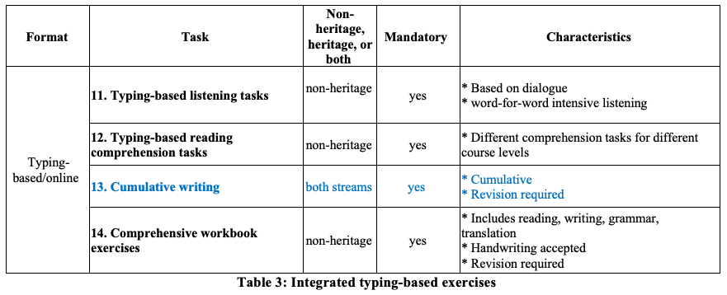
(3、4) 句子、篇章、综合应用、评量

Slide 17
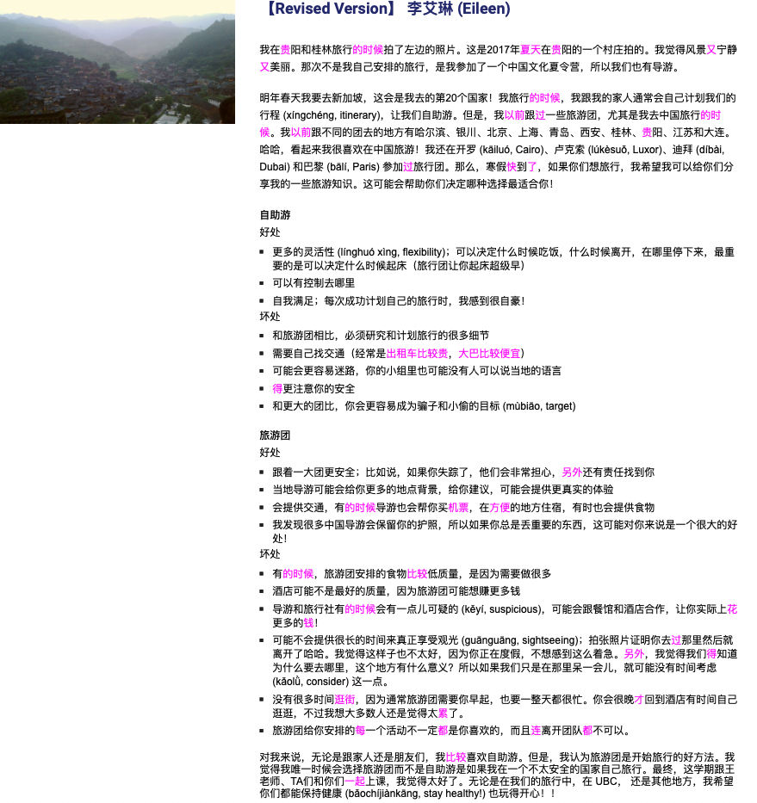
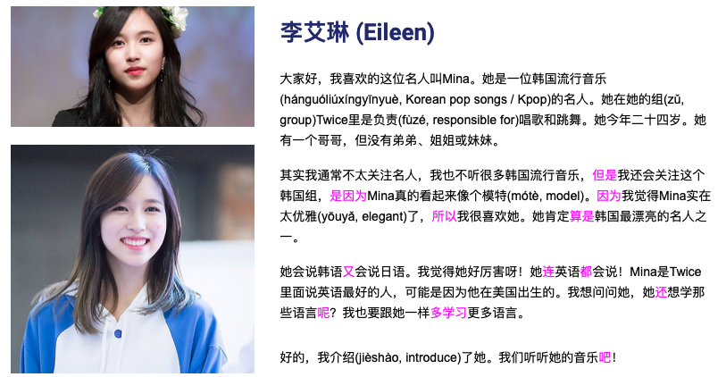
【Lesson Essay Writing by typing】书面表达质与量的提升
Notes:
手写能力不应该是华裔学生学习的天花板，而是地板。
电写能力可以

Slide 18
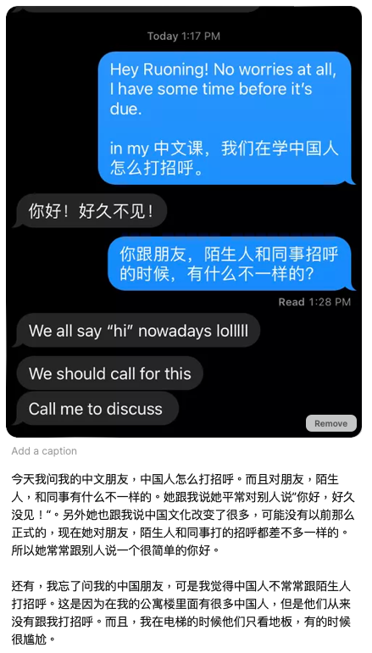
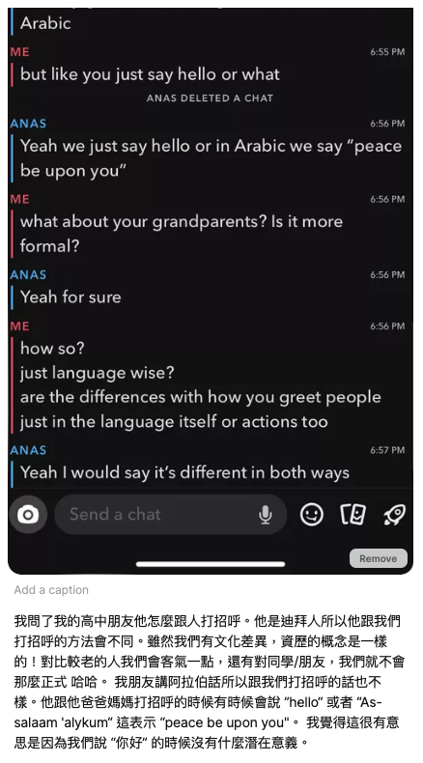
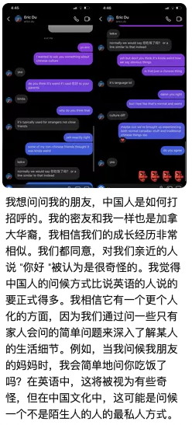
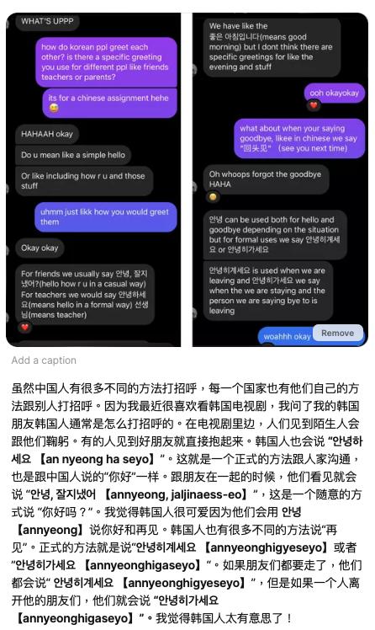
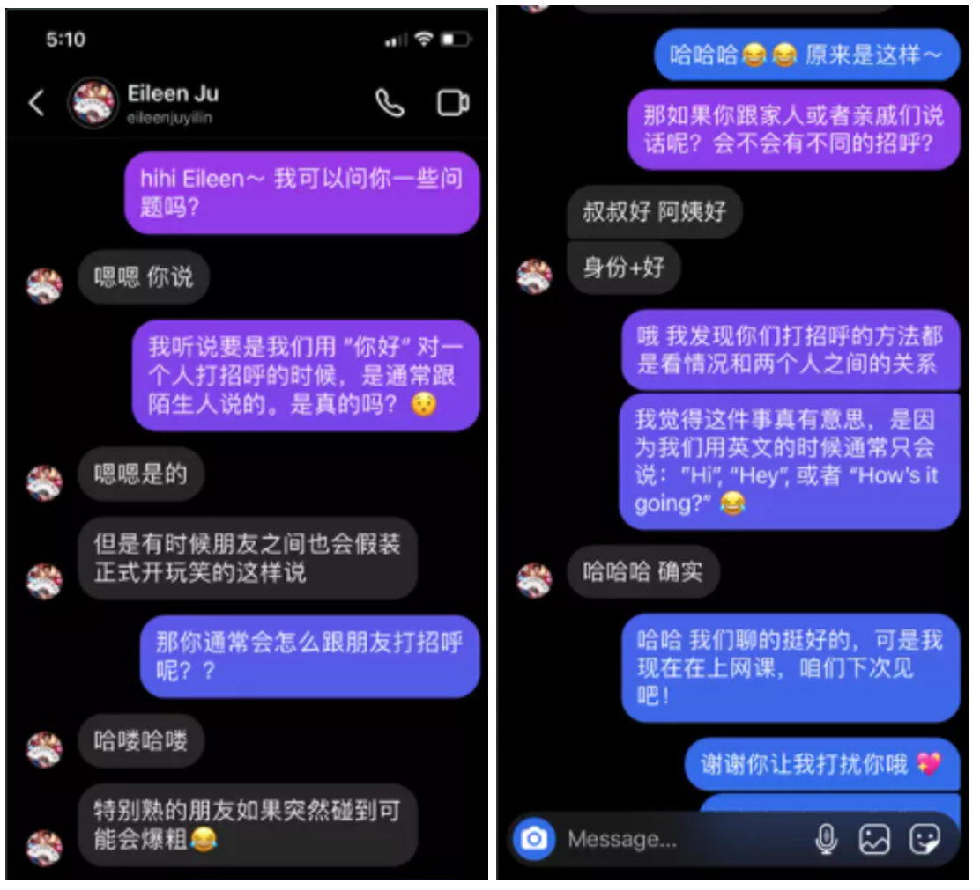
【采访朋友/电打】真实交际 + 真实语料：和朋友互动、跨文化理解
(华裔一的第一课 《“你好”去哪里了？》) 差异化、包容性

Slide 19
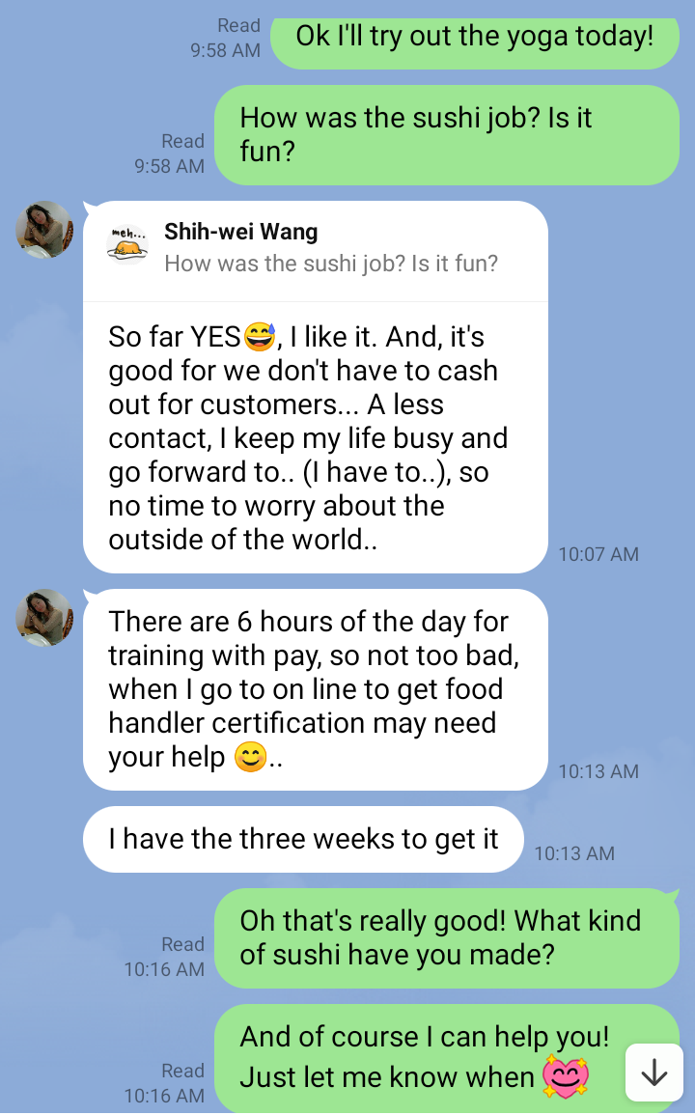
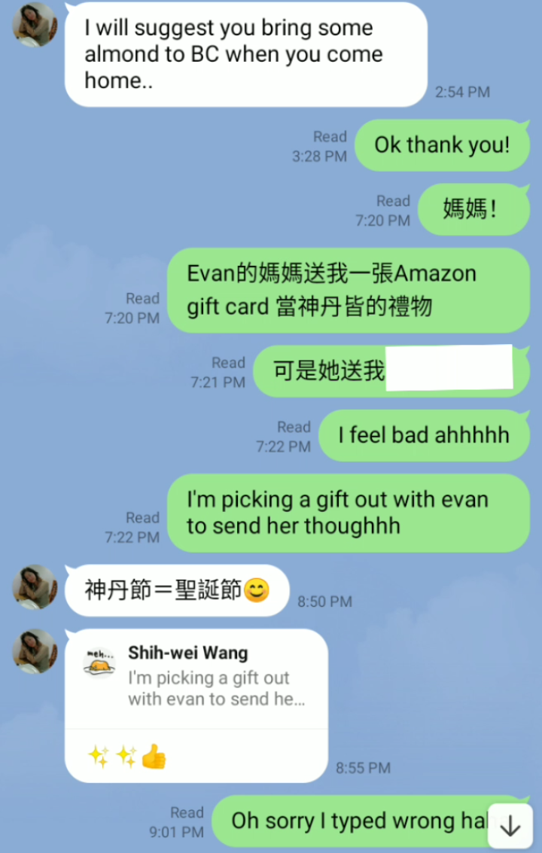
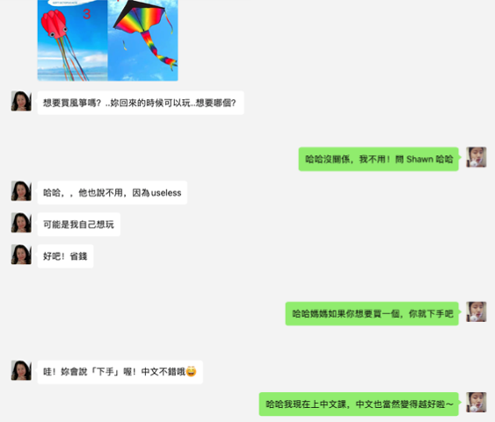
(非作业/电打) 真实交际 + 真实语料：和家人互动

Slide 20
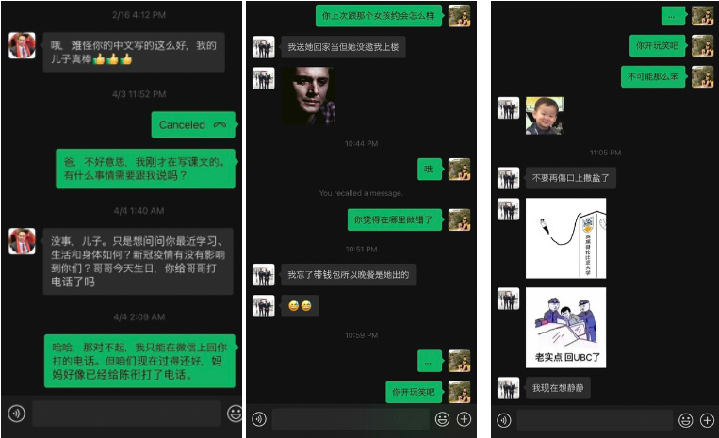
(非作业/电打) 真实交际 + 真实语料：和家人互动、情感联结
(华裔父亲“说”不出口的爱都在“字”里)

Slide 21
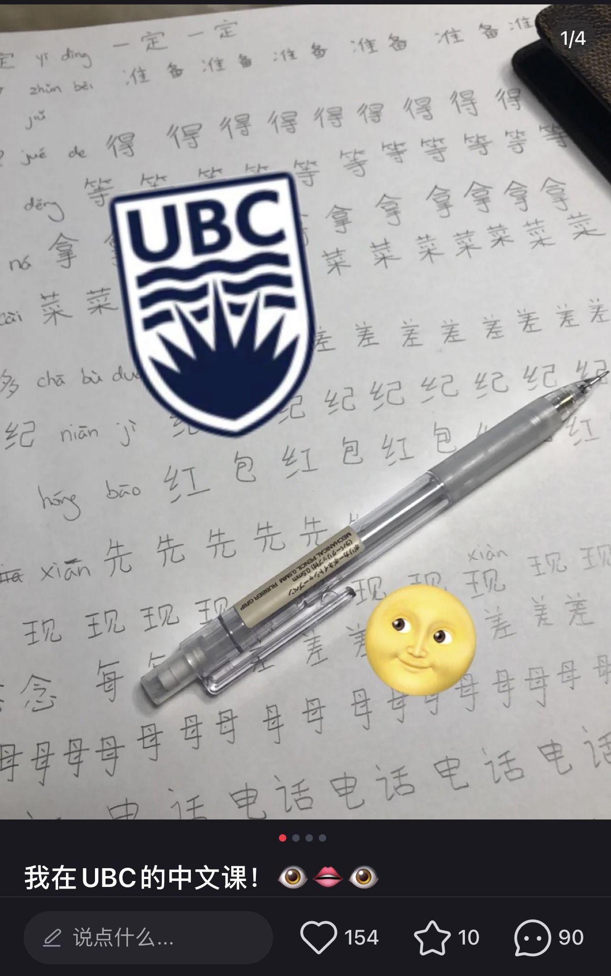
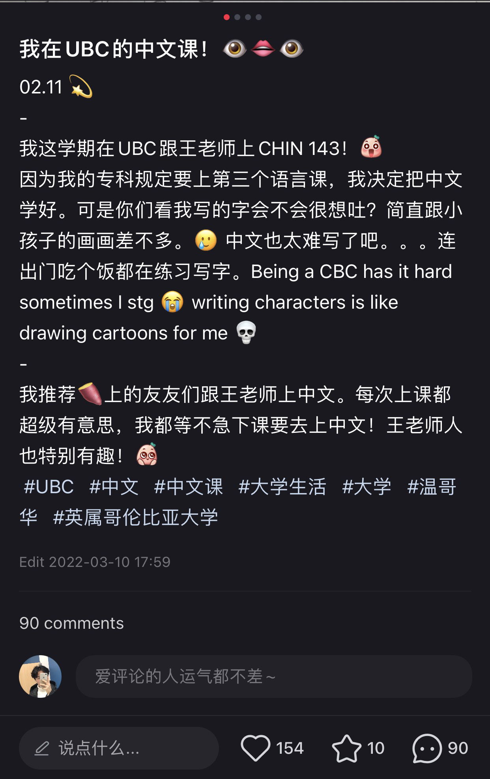
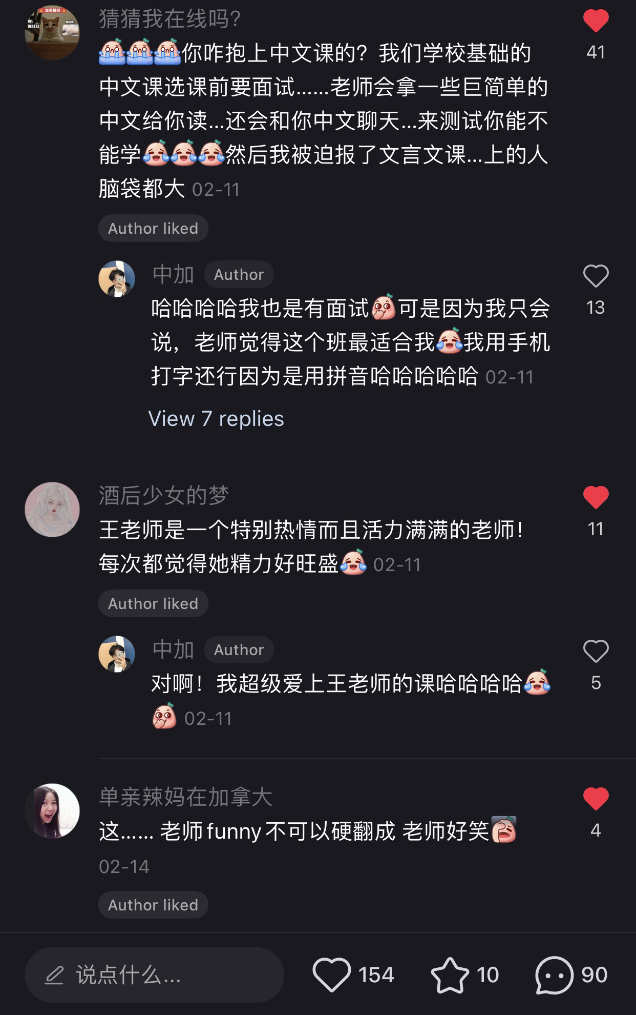
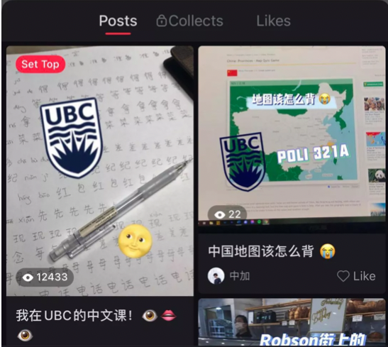
【小红书/电打】真实交际 + 真实语料：小红书上的语言和文化的冒险之旅 (self-chosen)
社群扩展、文化理解

Slide 22
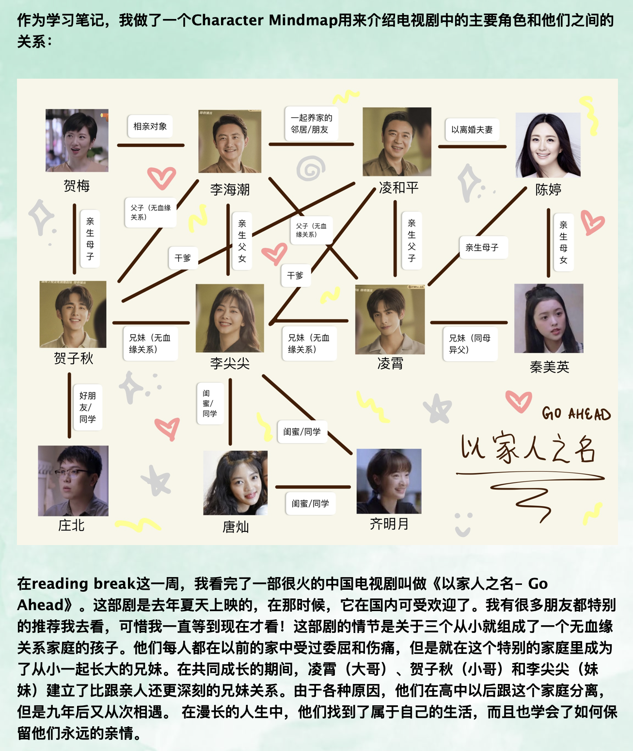
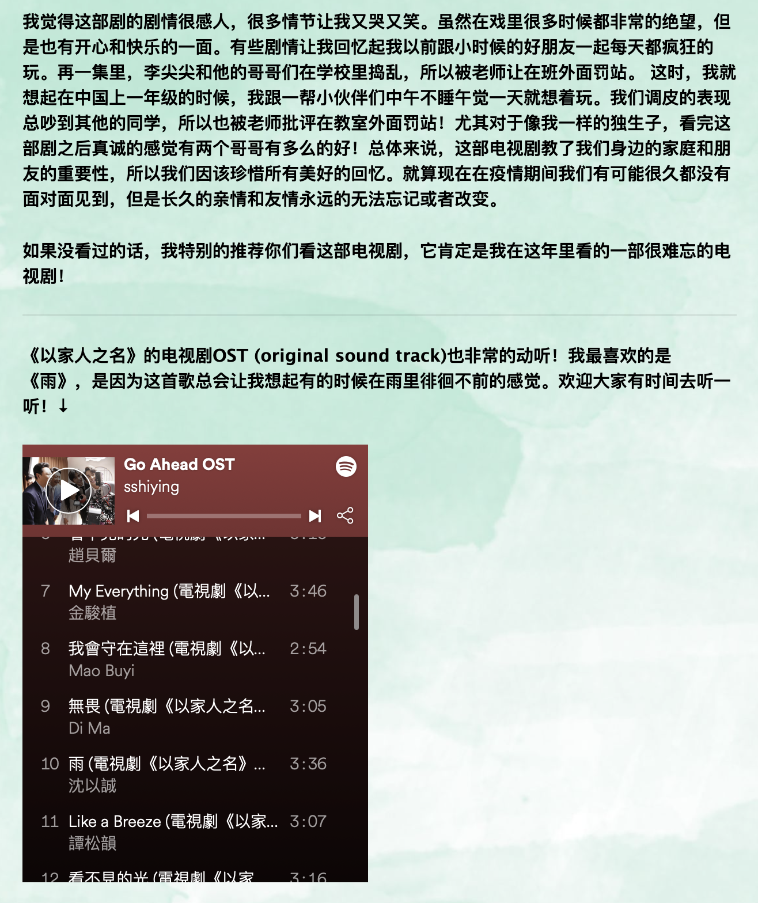
【Challenge Jeopardy】真实语料和流行文化的分享 (华裔二：练习说故事; narration)
社群建立、文化理解
Notes:
华裔二：练习说故事（narration）

Slide 23
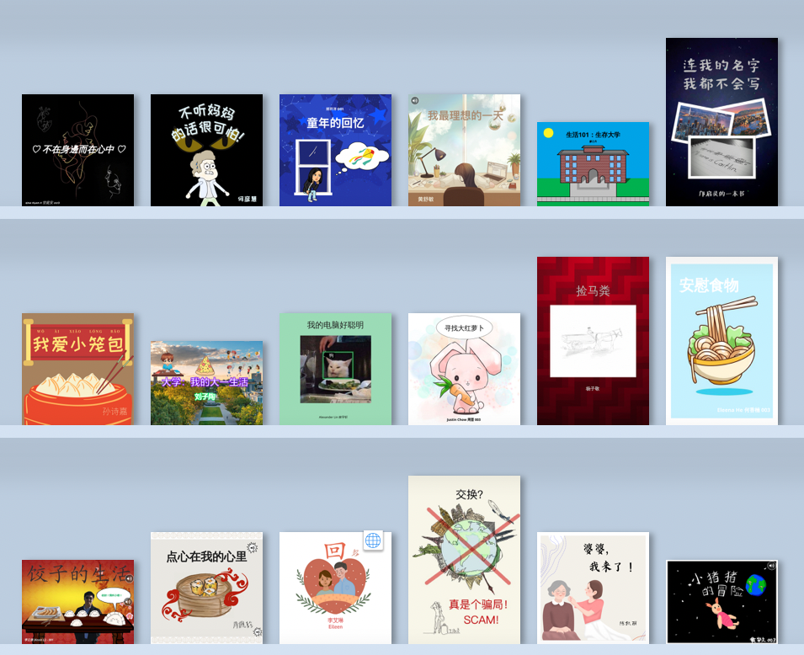
Typing-based Summative Assessment Tasks【Create Your Unique Book】 (华裔一)
其他学生的反馈：社群建立、扩展知识、刺激思考与讨论、扩展词汇、
Notes:
All major summative assessments in our Program have been redesigned to be typing-based (e.g. online book creation, e-Portfolio, Vlog, and learning reflections). Almost all types of questions used
in a traditional paper-based exam can be realized in a typing-based online exam. Midterms and final exams are also delivered and conducted online. In one final project, students are asked to tell their own story in a manner of their choice, which can be responded to in student feedback. One beginning- level heritage student created a book (figure 11) about her family history that integrates listening and reading, using a recording of her own voice reading each page of the online text.2 The first page notes: “This book introduces a Chinese heritage student’s observation and reflection on the process of her ethnic/cultural identification,” where she expresses deep feelings (including confusion) and thoughts on exploring her ethnic Hui background in the culturally diverse Canadian society. We find that the mixed-media posts help listeners understand the stories, increase their vocabulary, and learn characters more easily in this peer-review activity. Another student’s feedback after enjoying the book touches on the insights she gained about the Muslim religion and shifting attitudes of the Hui, one of China’s many ethnic (non-Han) minorities:

Slide 24
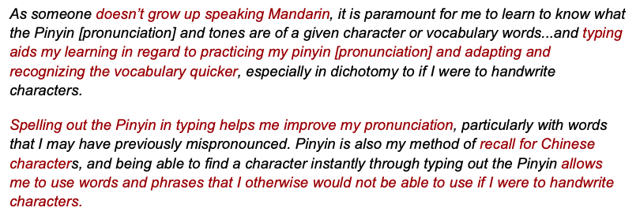
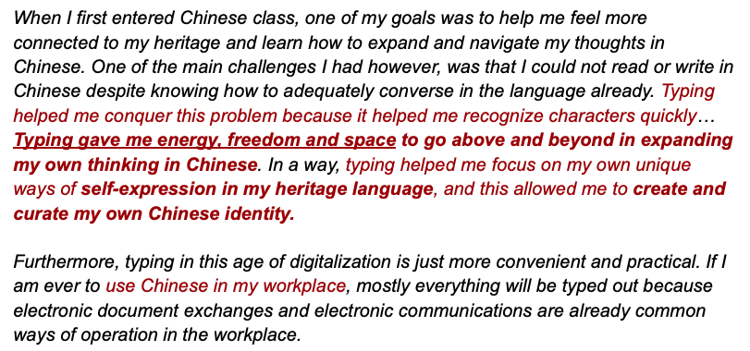
学生反馈

Slide 25
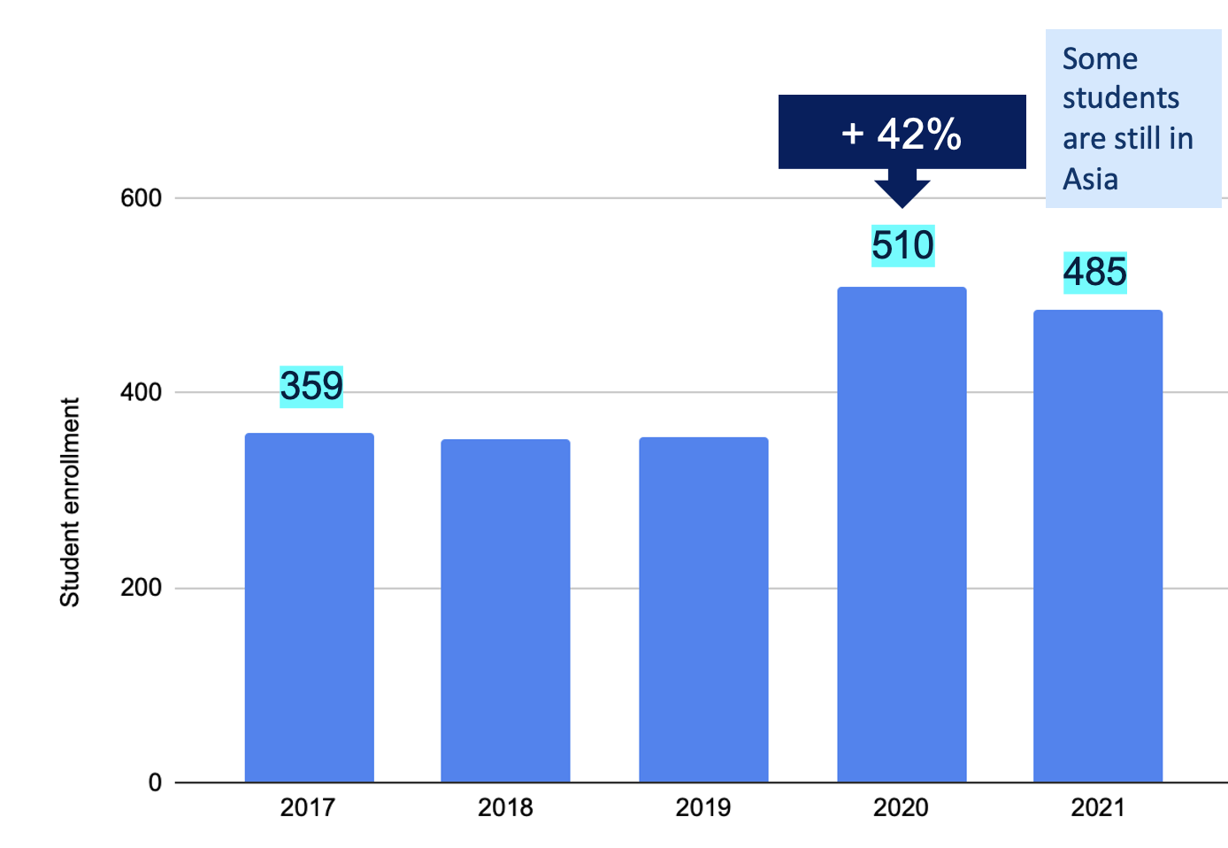
“电写为主、手写为辅”的好处与机会：
1.【语言】 书面的表达能力 (language output)
提高书面表达的广度、深度、复杂度
Note: 提高口语发音的准确度 (家里说方言的华裔学生、父母来自台湾的华裔学生)
2. 【语言】阅读(真实语料)的能力(language input)
加强音、义、形的连结；提高认字能力
扩大学生的词汇量 (增加认字的机会、使用更多元的词汇)
3. 文化理解(cultural competency)
华人文化的多样性；跨文化理解、交际能力
4. 社群认同与连结 (community, connection & identity)
与家人的情感交流、班级社群、华人网络社区、交际能力
5. 华裔学生的多元性、差异性和包容性 (EDI)
起点不同，终点接近
6. 学习兴趣与动机 (motivation)
7. 学生注册人数
入门门槛降低、降低学习焦虑、缩短学习曲线、加速学习
* 挑战🡪机会
教师对汉字教学的重新认识与学习
上下年级对学生的要求、教学方式的改动与衔接
Notes:
优化华裔学生的学习效益、效率、表现

Slide 26
欢迎老师们一起讨论、交流!
王祥寧
sunnie.wang@ubc.ca
University of British Columbia
Presented in L2 Hanzi Teaching and Learning in the Digital Age
Notes:
眼见为凭--》实例展示

